Slide 1
Strategies for Query Processing

Slide 2
Introduction
DBMS techniques to process a query
Scanner identifies query tokens
Parser checks the query syntax
Validation checks all attribute and relation names
Query tree (or query graph) created
Execution strategy or query plan devised
Query optimization
Planning a good execution strategy

Slide 3
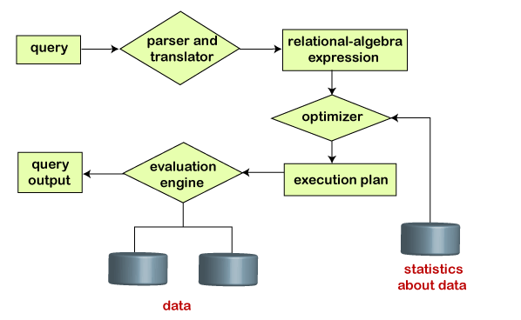
Query Processing
Figure 18.1 Typical steps when processing a high-level query

Slide 4
18.1 Translating SQL Queries into Relational Algebra and Other Operators
SQL
Query language used in most RDBMSs
Query decomposed into query blocks
Basic units that can be translated into the algebraic operators
Contains single SELECT-FROM-WHERE expression
May contain GROUP BY and HAVING clauses

Slide 5



Translating SQL Queries (cont’d.)
Example:
Inner block
Outer block

Slide 6


Translating SQL Queries (cont’d.)
Example (cont’d.)
Inner block translated into:
Outer block translated into:
Query optimizer chooses execution plan for each query block

Slide 7
Additional Operators Semi-Join and Anti-Join
Semi-join
Generally used for unnesting EXISTS, IN, and ANY subqueries
Syntax: T1 ⋉_{X=Y} T2 OR T1.x S= T2.y
T1 is the left table and T2 is the right table of the semi-join
A row of T1 is returned as soon as T1.X finds a match with any value of T2.Y without searching for further matches

Slide 8
Semi-Join Example
STUDENT |  |  |  | MEMBER |  |  |  | Semi join
RollNo | Name | Sex |  | Society | RollNo | role |  | (STUDENT ⋉ MEMBER)
101 | Isbah | F |  | Sports | 101 | member |  | RollNo | Name | Sex
102 | Izaan | M |  | Sports | 102 | member |  | 101 | Isbah | F
103 | Tahreem | F |  | Sports | 999 | Gen Sec |  | 102 | Izaan | M
104 | Khadija | F |  | Creative | 102 | member |  | 103 | Tahreem | F
111 | Alia | F |  | Creative | 103 | VP |  | 999 | Ismail | M
888 | Fatima | F |  | ACM | 102 | member
999 | Ismail | M
SQL: SELECT * FROM student
WHERE EXISTS (SELECT * FROM member
WHERE student.rollno=member.rollno

Slide 9
Inner-Join Example
STUDENT |  |  |  | MEMBER
RollNo | Name | Sex |  | Society | RollNo | role
101 | Isbah | F |  | Sports | 101 | member
102 | Izaan | M |  | Sports | 102 | member
103 | Tahreem | F |  | Sports | 999 | Gen Sec
104 | Khadija | F |  | Creative | 102 | member
111 | Alia | F |  | Creative | 103 | VP
888 | Fatima | F |  | ACM | 102 | member
999 | Ismail | M
(Inner) join
STUDENT ⋈ MEMBER
RollNo | Name | Sex | Society | rollNo | Role
101 | Isbah | F | Sports | 101 | member
102 | Izaan | M | Creative | 102 | member
102 | Izaan | M | Sports | 999 | Gen Sec
102 | Izaan | M | ACM | 102 | member
103 | Tahreem | F | Creative | 103 | VP
999 | Ismail | M | Sports | 999 | Gen Sec
SQL:
SELECT *
FROM student JOIN member
ON student.rollno=member.rollno

Slide 10
Additional Operators Semi-Join and Anti-Join (cont’d.)
Anti-join
Used for unnesting NOT EXISTS, NOT IN, and ALL subqueries
Syntax: T1 ▷_{X=Y} T2 OR T1.x A= T2.y
T1 is the left table and T2 is the right table of the anti-join
A row of T1 is rejected as soon as T1.x finds a match with any value of T2.y
A row of T1 is returned only if T1.x does not match with any value of T2.y

Slide 11
Anti-Join Example
STUDENT |  |  |  | MEMBER |  |  |  | Anti join
RollNo | Name | Sex |  | Society | RollNo | role |  | (STUDENT ▷ MEMBER)
101 | Isbah | F |  | Sports | 101 | member |  | RollNo | Name | Sex
102 | Izaan | M |  | Sports | 102 | member |  | 104 | Khadija | F
103 | Tahreem | F |  | Sports | 999 | Gen Sec |  | 111 | Alia | F
104 | Khadija | F |  | Creative | 102 | member |  | 888 | Fatima | F
111 | Alia | F |  | Creative | 103 | VP
888 | Fatima | F |  | ACM | 102 | member
999 | Ismail | M
SQL: SELECT * FROM student
WHERE NOT EXISTS (SELECT * FROM member
WHERE student.rollno=member.rollno

Slide 12
18.2 Algorithms for External Sorting
Sorting is an often-used algorithm in query processing
External sorting
Algorithms suitable for large files that do not fit entirely in main memory
Sort-merge strategy based on sorting smaller subfiles (runs) and merging the sorted runs
Requires buffer space in main memory
DBMS cache

Slide 13
Algorithms for External Sorting (cont’d.)
Degree of merging
Number of sorted subfiles that can be merged in each merge step
Performance of the sort-merge algorithm
Number of disk block reads and writes before sorting is completed
The following formula approximates this cost:
(2 * b) + (2 * b * (log_{dM} b/k))

Slide 14
18.3 Algorithms for SELECT Operation
SELECT operation
Search operation to locate records in a disk file that satisfy a certain condition
File scan or index scan (if search involves an index)

Slide 15
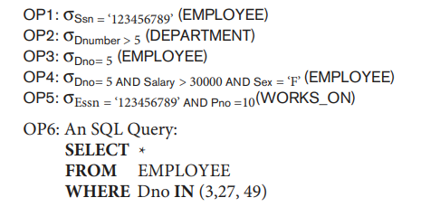
Algorithms for SELECT Operation
Search methods for simple selection
S1: Linear search (brute force algorithm)
S2: Binary search
S3a: Using a primary index
S3b: Using a hash key
Notes:
skjkfjkjkjgkjgkgjkgjg

Slide 16
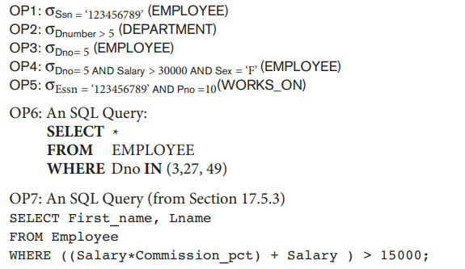
Algorithms for SELECT Operation (cont’d.)
Search methods for simple selection (cont’d.)
S4: Using a primary index to retrieve multiple records
S5: Using a clustering index to retrieve multiple records
S6: Using a secondary (B+ -tree) index on an equality comparison and for range
S7a: Using a bitmap index
S7b: Using a functional index

Slide 17
Algorithms for SELECT Operation (cont’d.)
Search methods for conjunctive (logical AND) selection
Using an individual index
Using a composite index
Intersection of record pointers
Disjunctive (logical OR) selection
Harder to process and optimize
Notes:
SELECT * FROM employees WHERE department = 'Sales' AND salary > 50000;
Individual Index creation: { Fetch the records individually ,then intersect}
CREATE INDEX idx_department ON employees (department);
CREATE INDEX idx_salary ON employees (salary);
Using a composite index: Fetch the result that is basically satisfy the both condition simultaneously
CREATE INDEX idx_department_salary ON employees (department, salary);
Intersection of record pointers:
-- Select employee IDs who are in the Sales department
SELECT employee_id FROM employees WHERE department = 'Sales‘
INTERSECT
-- Select employee IDs who have a salary greater than $50,000
SELECT employee_id FROM employees WHERE salary > 50000;
This approach efficiently finds the intersection of record pointers that satisfy all specified conditions, effectively performing conjunctive selection using SQL.

Slide 18
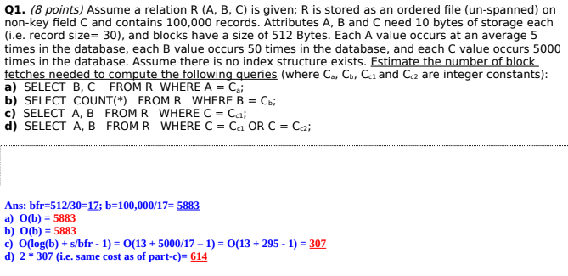
Problem

Slide 19
Algorithms for SELECT Operation (cont’d.)
Selectivity
Ratio of the number of records (tuples) that satisfy the condition to the total number of records (tuples) in the file
Number between zero (no records satisfy condition) and one (all records satisfy condition)
Query optimizer receives input from system catalog to estimate selectivity

Slide 20

Selectivity calculation
Selectivity on Equality
sl(ration)= No of records that satisfied condition / total records
Total fetched records= total records * sl(ration)
Selectivity for range queries

Slide 21
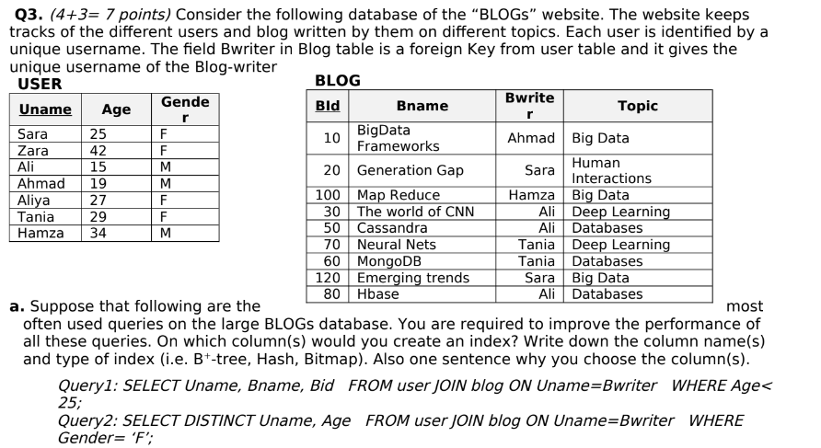
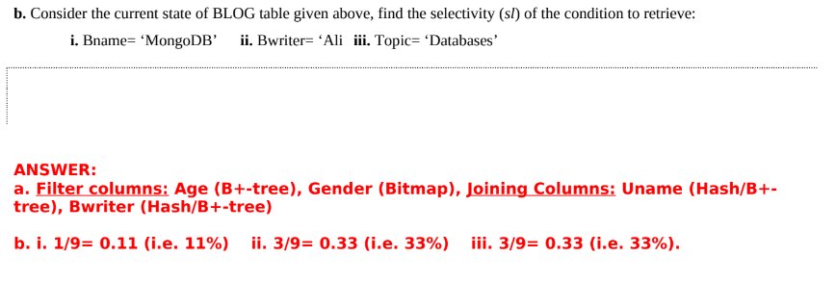
Problem
Notes:
For range Age>=16
using formula
sl=42-16/42-15=0.96
Total records= 7*.96=6.7 = 6 records

Slide 22
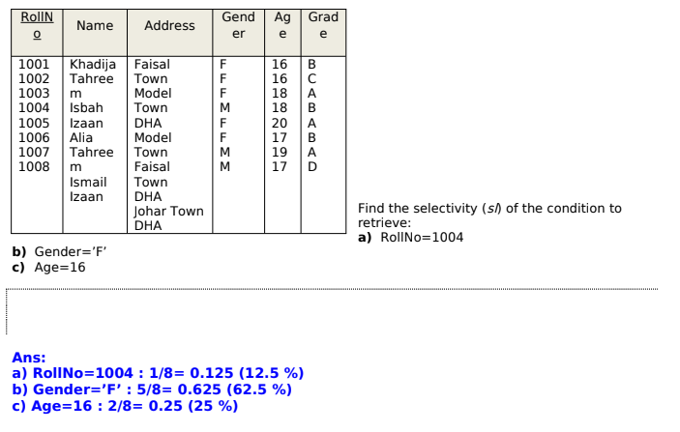
Problem

Slide 23
18.4 Implementing the JOIN Operation
JOIN operation
One of the most time consuming in query processing
EQUIJOIN (NATURAL JOIN)
Two-way or multiway joins
Methods for implementing joins
J1: Nested-loop join (nested-block join)
J2: Index-based nested-loop join
J3: Sort-merge join
J4: Partition-hash join

Slide 24
Implementing the JOIN Operation (cont’d.)
Available buffer space has important effect on some JOIN algorithms
Nested-loop approach
Read as many blocks as possible at a time into memory from the file whose records are used for the outer loop
Choice of outer-loop file affect performance of NLJ
Advantageous to use the file with fewer blocks as the outer-loop file

Slide 25
Example: EMPLOYEE ⋈_{Dno=Dnumber} DEPARTMENT
Assume that the number of buffers available in main memory for implementing the join is k= n_{b} = 7 blocks. The DEPARTMENT file consist of r_{D} = 50 record stored in b_{D} = 10 disk blocks and that the EMPLOYEE file consists of r_{E} = 6000 record stored in b_{E} = 2000 disk blocks.
Total number of block accessed for outer-loop file = b_{E}
No of times (n_{b} - 2) blocks of outer file are loaded into mem.= ⌈b_{E} /(n_{b} - 2)⌉
Total number of block accessed for inner-loop file = ⌈b_{E} /(n_{b} - 2)⌉ * b_{D}
Hence, total no of block accesses (If EMPLOYEE records in outer-loop):
b_{E} + (⌈b_{E} /(n_{b} - 2)⌉ * b_{D}) = 2000 + ( ⌈ 2000/5 ⌉ * 10) = 6000 block accesses
If we use DEPARTMENT records in the outer-loop, by symmetry:
b_{D} + (⌈b_{D} /(n_{b} - 2)⌉ * b_{E}) = 10 + ( ⌈ 10/5 ⌉ * 2000) = 4010 block accesses
Additional b_{RES} (blocks of result file of join operation) should be added.
Notes:
Additional b_{RES} (blocks of result file of join operation) should be added. The blocks that are using to hold the result will also a added to the total block access. If the result blocks result filled then written back to disk file or append with result file and prepare for next join result.
Note: check advantage to use fewer blocks as outer loop
(Nb-2): 1 block for inner loop to read the block, 1 for to write the result or output file

Slide 26
Implementing the JOIN Operation (cont’d.)
Join selection factor
Fraction of records in one file that will be joined with records in another file
Depends on the particular equijoin condition with another file
Affects join performance

Slide 27
Example: DEPARTMENT ⋈_{Mgr_ssn=Ssn} EMPLOYEE
Suppose that secondary indexes exist on both the attributes
Ssn of employee and Mgr_ssn of department,
with the number of index levels X_{Ssn} = 4 and X_{Mgr_ssn} = 2, respectively.
Option1: Retrieve each employee record and then uses the index on Mgr_ssn of department to find a matching department record.
The no of block accesses for this case:
b_{E} + (r_{E} * (X_{Mgr_ssn} + 1)) = 2000 + (6000 * (2 + 1)) = 20,000 block accesses
(join selection factor of employee is 50/6000, or 0.8%)
Option2: Retrieve each department record and then uses the index on Ssn of employee to find a matching manager employee record.
The no of block accesses for this case:
b_{D} + (r_{D} * (X_{Ssn} + 1)) = 10 + (50 * (4 + 1)) = 260 block accesses
(join selection factor of department is 50/50, or 100%)
Notes:
Rd is 50

Slide 28
Sort Merge Join
If the records of R and S are physically sorted (ordered) by value of the join attributes A and B, respectively, we can implement the join in the most efficient way possible. Both files are scanned concurrently in order of the join attributes, matching the records that have the same values for A and B. If the files are not sorted, they may be sorted first by using external sorting

Slide 29
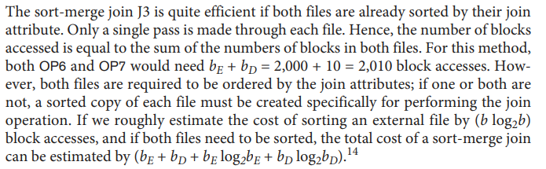
Example: DEPARTMENT ⋈_{Mgr_ssn=Ssn} EMPLOYEE

Slide 30
Implementing the JOIN Operation (cont’d.)
Partition-hash join
Each file is partitioned into M partitions using the same partitioning hash function on the join attributes
Each pair of corresponding partitions is joined

Slide 31
18.5 Algorithms for PROJECT and Set Operations
PROJECT operation
After projecting R on only the columns in the list of attributes, any duplicates are removed by treating the result strictly as a set of tuples
Implementation:
1. By sorting (remove the consecutive records having same value)
2. Hashing ( don't insert the duplicate result in the bucket)
Default for SQL queries
No elimination of duplicates from the query result
Duplicates eliminated only if the keyword DISTINCT is included
Notes:
Projection return result by removing the duplicate if It is applied on none key attribute

Slide 32
Algorithms for PROJECT and Set Operations (cont’d.)
Set operations (Type compatible)
UNION
INTERSECTION
SET DIFFERENCE
CARTESIAN PRODUCT(resultant rows=R*S, resultant column=n+m)
Set operations sometimes expensive to implement
Sort-merge technique
Hashing
Notes:
R,S are both tables and having n,m columns respectively

Slide 33
Sort-merge technique
The customary way to implement these operations is to use variations of the sort-merge technique: the two relations are sorted on the same attributes, and, after sorting, a single scan through each relation is sufficient to produce the result. For example, we can implement the UNION operation, R ∪ S, by scanning and merging both sorted files concurrently, and whenever the same tuple exists in both relations, only one is kept in the merged result. For the INTERSECTION operation, R ∩ S, we keep in the merged result only those tuples that appear in both sorted relations.

Slide 34
Hashing
Hashing can also be used to implement UNION, INTERSECTION, and SET DIFFERENCE. One table is first scanned and then partitioned into an in-memory hash table with buckets, and the records in the other table are then scanned one at a time and used to probe the appropriate partition. For example, to implement R ∪ S, first hash (partition) the records of R; then, hash (probe) the records of S, but do not insert duplicate records in the buckets. To implement R ∩ S, first partition the records of R to the hash file. Then, while hashing each record of S, probe to check if an identical record from R is found in the bucket, and if so add the record to the result file. To implement R – S, first hash the records of R to the hash file buckets. While hashing (probing) each record of S, if an identical record is found in the bucket, remove that record from the bucket.

Slide 35
Algorithms for PROJECT and Set Operations (cont’d.)
Use of anti-join for SET DIFFERENCE
EXCEPT or MINUS in SQL
Example: Find which departments have no employees
becomes
RA: DEPARTMENT ▷_{Dnumber=Dno} EMPLOYEE
SQL: SELECT * FROM department, employee
WHERE department.Dnumber A= employee.Dno
(Non-standard notation for anti-join)

Slide 36

18.6 Implementing Aggregate Operations and Different Types of JOINs
Aggregate operators
MIN, MAX, COUNT, AVERAGE, SUM
Can be computed by a table scan or using an appropriate index
Example:
If an (ascending) B+ -tree index on Salary exists:
Optimizer can use the Salary index to search for the largest Salary value
Follow the rightmost pointer in each index node from the root to the rightmost leaf

Slide 37
Implementing Aggregate Operations and Different Types of JOINs (cont’d.)
AVERAGE or SUM
Index can be used if it is a dense index
Computation applied to the values in the index
COUNT
Number of values can be computed from the index

Slide 38
Implementing Aggregate Operations and Different Types of JOINs (cont’d.)
Standard JOIN (called INNER JOIN in SQL)
Variations of joins
Outer join
Left, right, and full
Example:
Semi-Join
Anti-Join
Non-Equi-Join

Slide 39
18.7 Combining Operations Using Pipelining
SQL query translated into relational algebra expression
Sequence of relational operations
Materialized evaluation
Creating, storing, and passing temporary results
General query goal: minimize the number of temporary files
Pipelining or stream-based processing
Combines several operations into one
Avoids writing temporary files

Slide 40
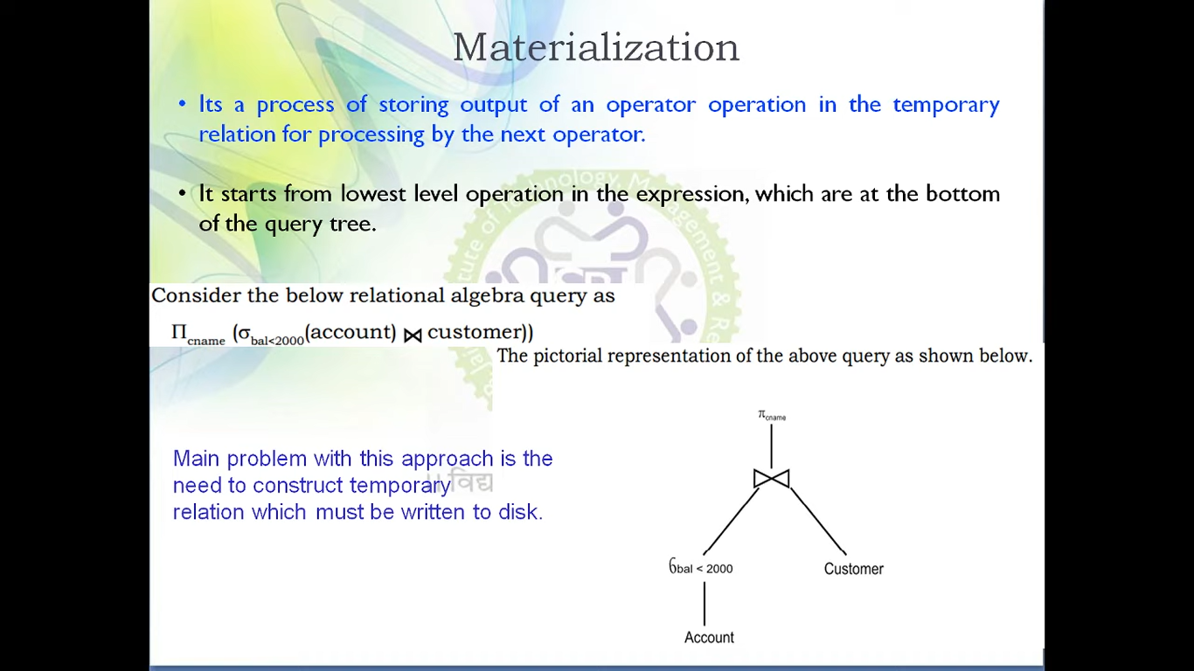
Materialization

Slide 41
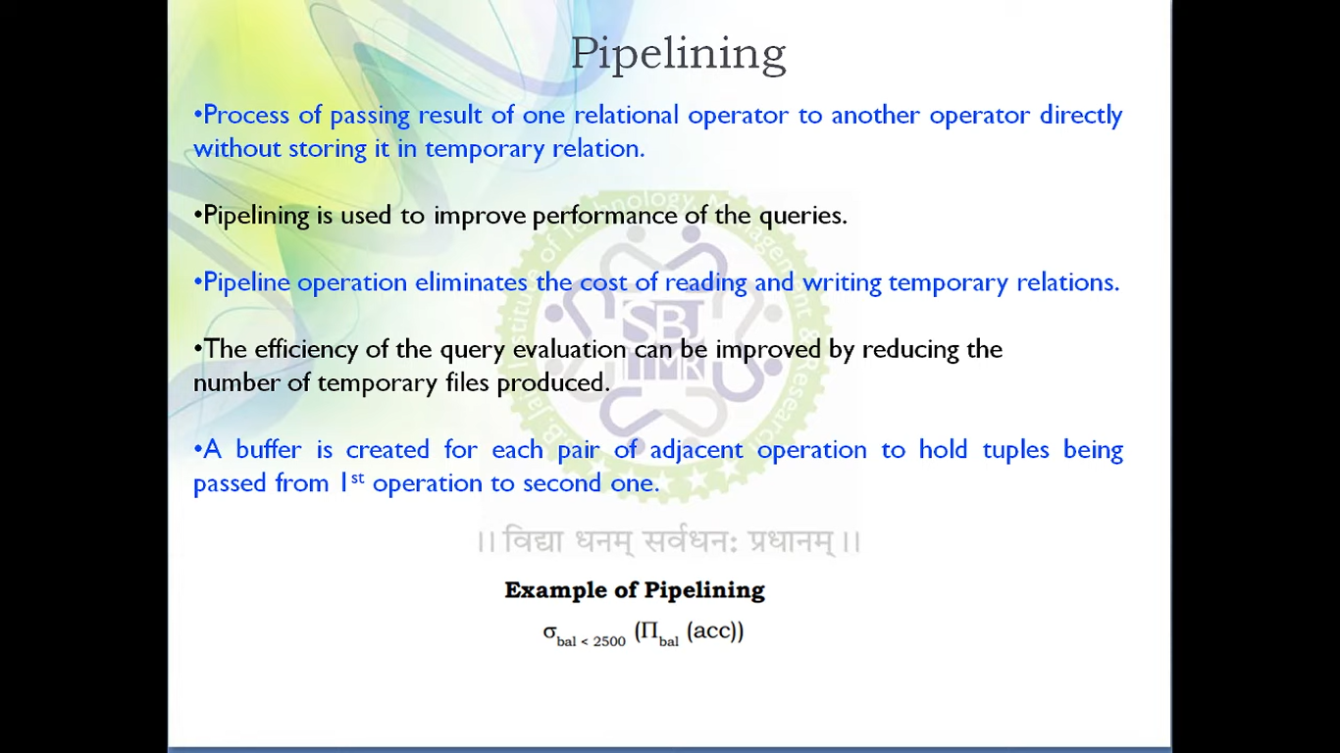
Pipelining

Slide 42
Combining Operations Using Pipelining (cont’d.)
Pipelined evaluation benefits
Avoiding cost and time delay associated with writing intermediate results to disk
Being able to start generating results as quickly as possible
Iterator
Operation implemented in such a way that it outputs one tuple at a time
Many iterators may be active at one time

Slide 43
Combining Operations Using Pipelining (cont’d.)
Iterator interface methods
Open()
Get_Next()
Close()

Slide 44
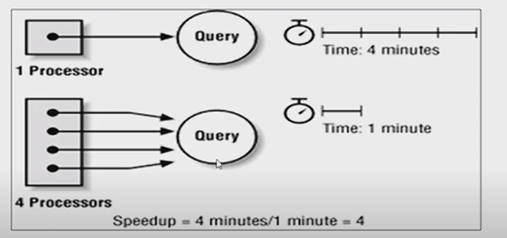
Query Parallelism

Slide 45
Parallel Architectures and Algorithms
Architectures
1. Shared-memory architecture
2. Shared-disk architecture
3. Shared-nothing architecture
Algorithms
1. Operator-level parallelism
2. IntraQuery-level parallelism
3. InterQuery-level parallelism
Notes:
Parallel Architectures and Algorithms needed to execute the query parallel and increase the execution performance

Slide 46
18.8 Parallel Algorithms for Query Processing
Parallel database architecture approaches
Shared-memory architecture
Multiple processors can access common main memory region
Shared-disk architecture
Every processor has its own memory
Machines have access to all disks
Shared-nothing architecture
Each processor has own memory and disk storage
Most commonly used in parallel database systems

Slide 47
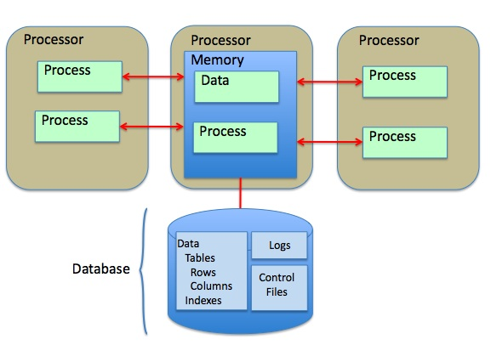
Shared-memory architecture Multiple processors can access common main memory region

Slide 48
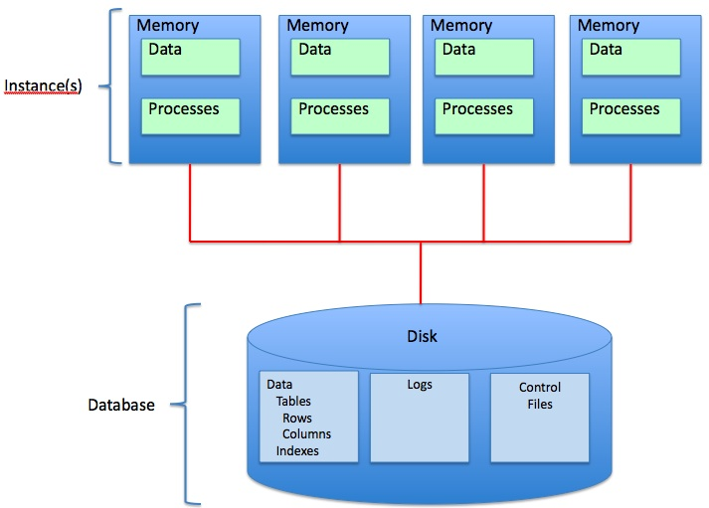
Shared-disk architecture Every processor has its own memory and Machines have access to all disks

Slide 49
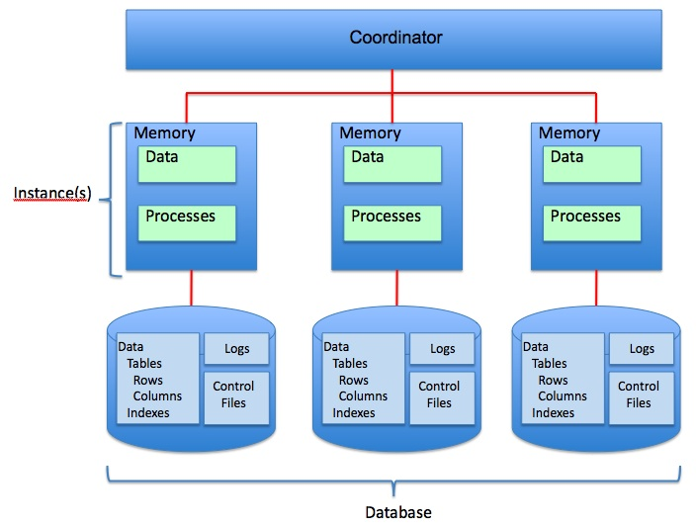
Shared-nothing architecture Each processor has own memory and disk storage

Slide 50
Parallel Algorithms for Query Processing (cont’d.)
Linear speed-up
Linear reduction in time taken for operations
Linear scale-up
Constant sustained performance by increasing the number of processors and disks

Slide 51
Parallel Algorithms for Query Processing (cont’d.)
Operator-level parallelism
Horizontal partitioning
Round-robin partitioning
Range partitioning
Hash partitioning
Sorting
If data has been range-partitioned on an attribute:
Each partition can be sorted separately in parallel
Results concatenated
Reduces sorting time

Slide 52
Parallel Algorithms for Query Processing (cont’d.)
Selection
If condition is an equality condition on an attribute used for range partitioning:
Perform selection only on partition to which the value belongs
Projection without duplicate elimination
Perform operation in parallel as data is read
Duplicate elimination
Sort tuples and discard duplicates

Slide 53
Parallel Algorithms for Query Processing (cont’d.)
Parallel joins divide the join into n smaller joins
Perform smaller joins in parallel on n processors
Take a union of the result
Parallel join techniques
Equality-based partitioned join
Inequality join with partitioning and replication
Parallel partitioned hash join

Slide 54
Parallel Algorithms for Query Processing (cont’d.)
Aggregation
Achieved by partitioning on the grouping attribute and then computing the aggregate function locally at each processor
Set operations
If argument relations are partitioned using the same hash function, they can be done in parallel on each processor

Slide 55
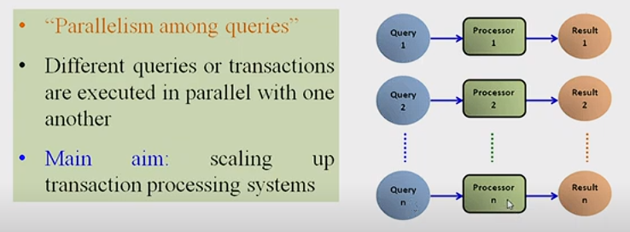
Interquery parallelism
Notes:
Interquery parallelism
Execution of multiple queries in parallel
Goal: scale up
Difficult to achieve on shared-disk or shared-nothing architectures

Slide 56
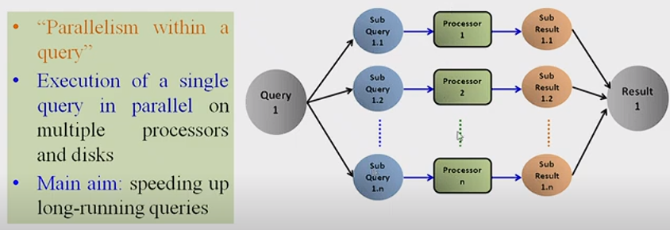
Intraquery parallelism
Notes:
Intraquery parallelism
Approaches
Use parallel algorithm for each operation, with appropriate partitioning of the data input to that operation
Execute independent operations in parallel

Slide 57
18.9 Summary
SQL queries translated into relational algebra
External sorting
Selection algorithms
Join operations
Combining operations to create pipelined execution
Parallel database system architectures

